Slide 1

Enhanced Entity Relationship Model (EER Model)
Department of Computer Engineering and Applications

Slide 2
Enhanced-ER (EER) Model Concepts
EER is a high-level data model that incorporates the extensions to the original ER model.
In addition to ER model concepts EE-R includes −
Subclasses and Super classes.
Specialization and Generalization.
Category or union type.
Aggregation.

Slide 3
Sub Class and Super Class
Super class is an entity that can be divided into further subtype. For example − consider Shape super class.
Super class shape has sub groups: Triangle, Square and Circle.
Sub classes are the group of entities with some unique attributes. Sub class inherits the properties and attributes from super class.

Slide 4
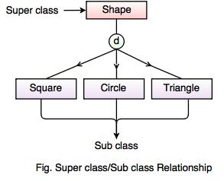
Super class/Sub Class

Slide 5
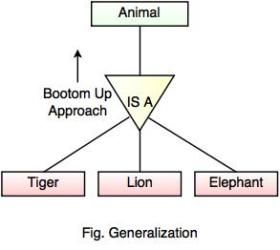
Generalization
Generalization is the process of generalizing the entities which contain the properties of all the generalized entities.
It minimizes the difference between the entities by identifying the common features.
In the above example, Tiger, Lion, Elephant can all be generalized as Animals.

Slide 6
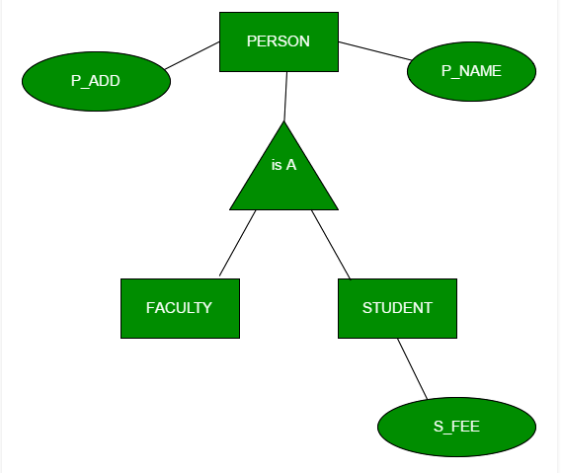
Generalization

Slide 7
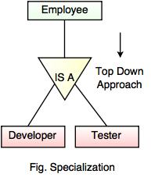
Specialization
Specialization is a process of identifying subsets of an entity that share some different characteristic. It is a top down approach in which one entity is broken down into low level entity.
It maximizes the difference between the members of an entity by identifying the unique characteristic or attributes of each member.

Slide 8
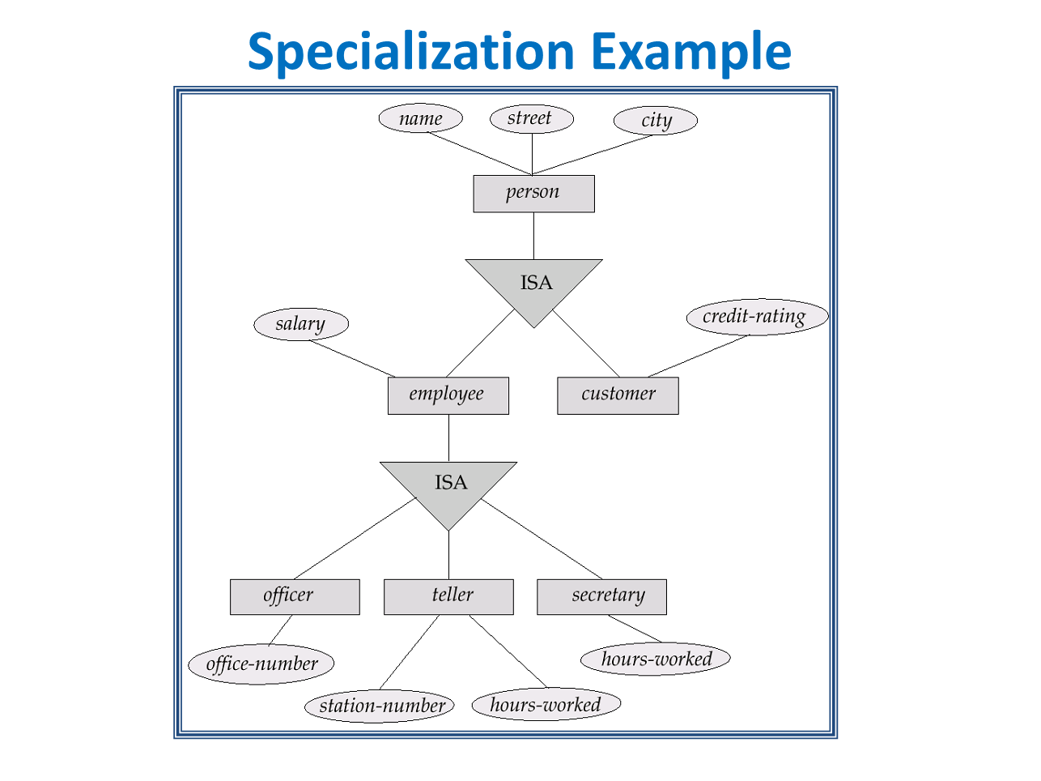

Slide 9
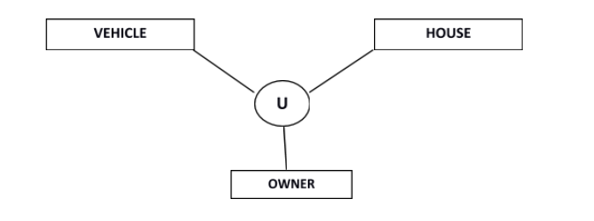
Category or Union
Relationship of one super or sub class with more than one super class.
Owner is the subset of two super class: Vehicle and House.

Slide 10
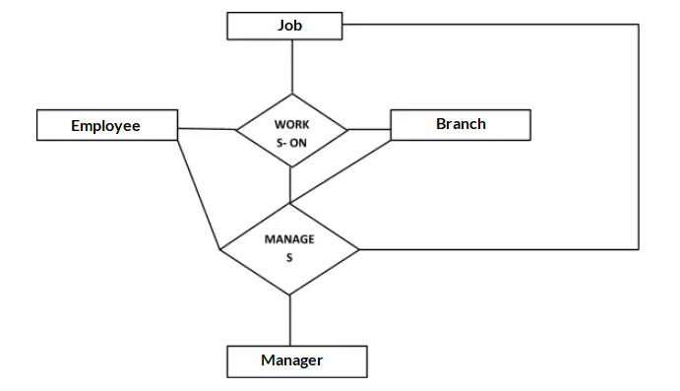
Aggregation
Aggregation is a process that represent a relationship between a whole object and its component parts.

Slide 11
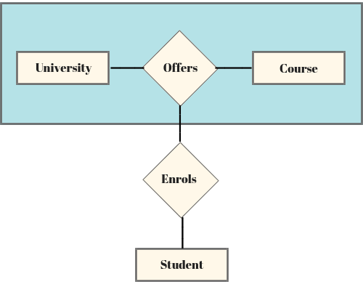

Slide 12
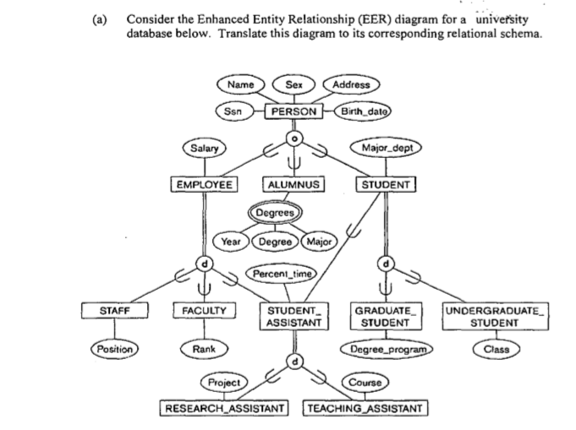

Slide 13
Thank You

